Slide 1


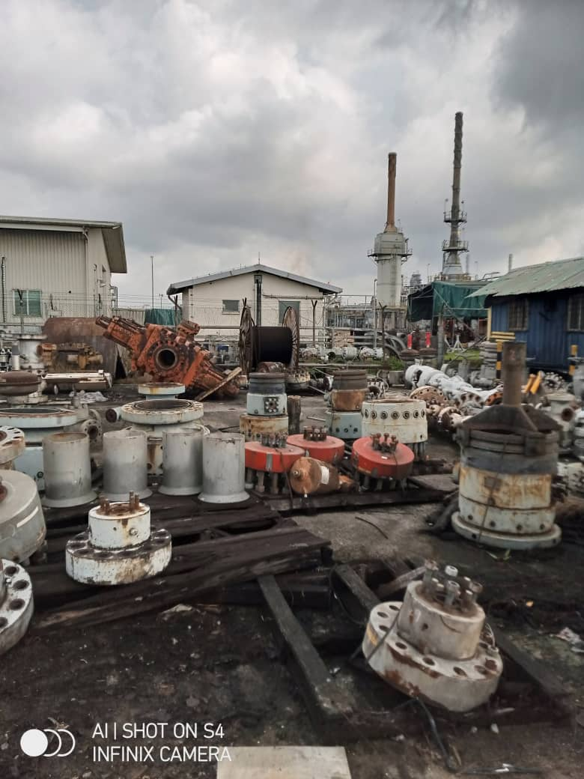
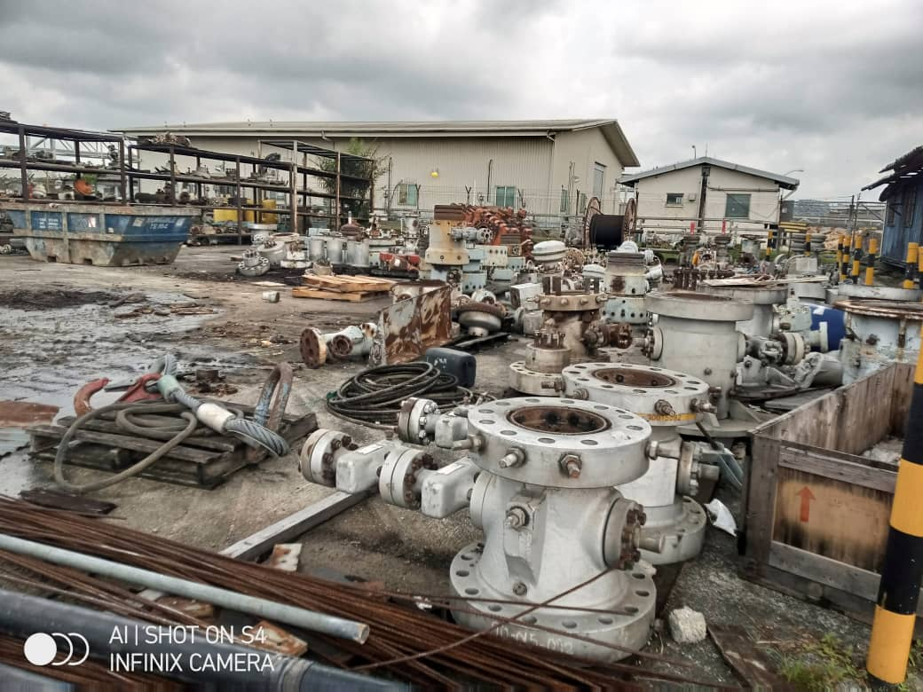
Scope of Application…
Preservation of Outdoor Stored Equipment
Scope of activity includes:
Visual Inspection
Cleaning / Buffing
Greasing/Oiling
Refurbishment (as might be applicable)
Application of Guardian Protective Solution

Slide 2
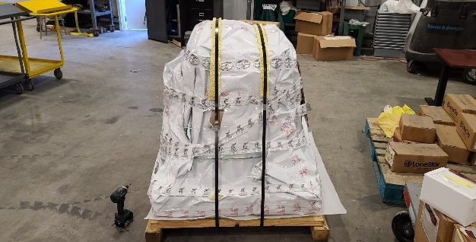
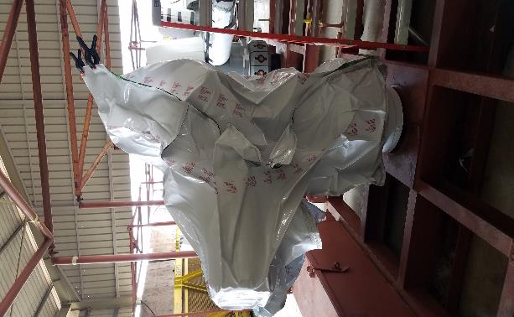
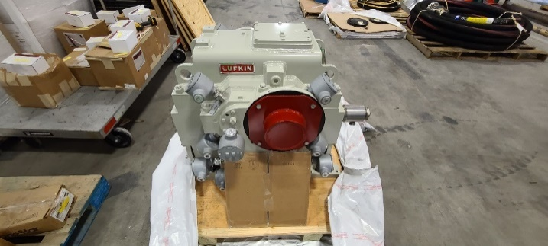
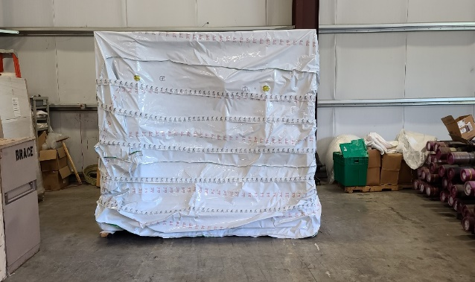
Scope of Application…continued
Preservation of Indoor/Sheltered Equipment
Scope of activity includes:
Visual Inspection
Cleaning / Buffing
Greasing/Oiling
Refurbishment (as might be applicable)
Blasting & Painting (as might be required)
Application of Guardian Protective Solution

Slide 3
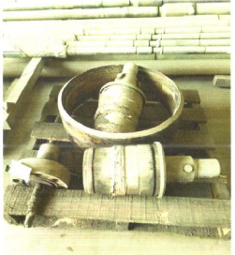
Client References…
ExxonMobil Nigeria – Provision of Preservation Services at Onne (Shorebase & USAN), Nigeria
Before After Before After

Slide 4
Client References…
ExxonMobil Nigeria – Provision of Preservation Services at Onne (Shorebase & USAN), Nigeria
Before After Before After

Slide 5
Client References…
ExxonMobil Nigeria – Provision of Preservation Services at Onne (Shorebase & USAN), Nigeria
Before After Before After

Slide 6
Client References…
ExxonMobil Nigeria – Provision of Preservation Services at Onne (Shorebase & USAN), Nigeria
Before After Before After

Slide 7
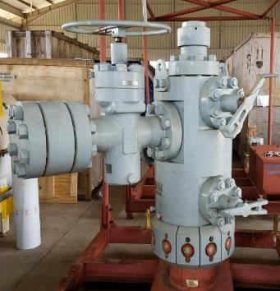
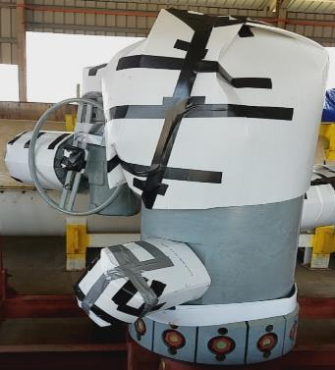
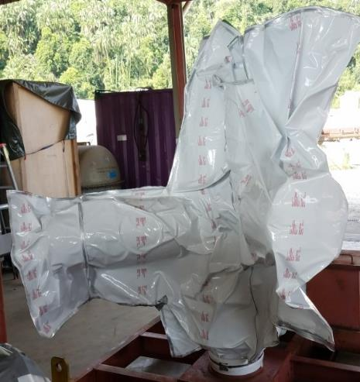
Client References…
ExxonMobil Malaysia – Preservation of Xmas Tree Equipment
Before After

Slide 8
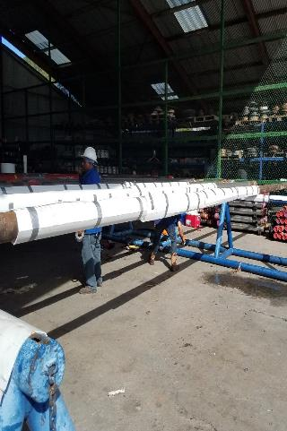
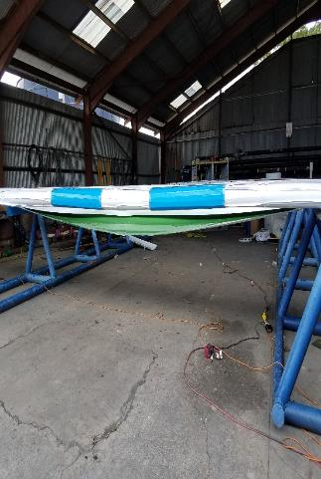
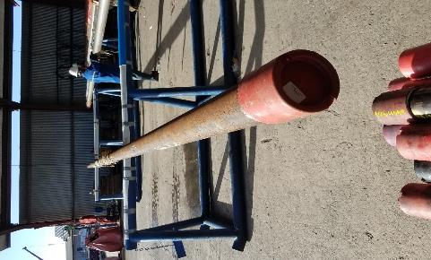
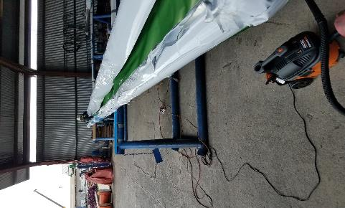
Client References…
EOG – Preservation of Running Tools
Before After

Slide 9
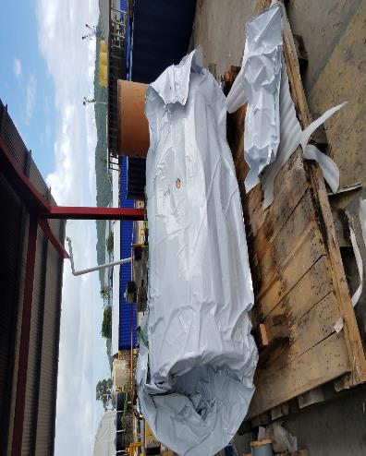
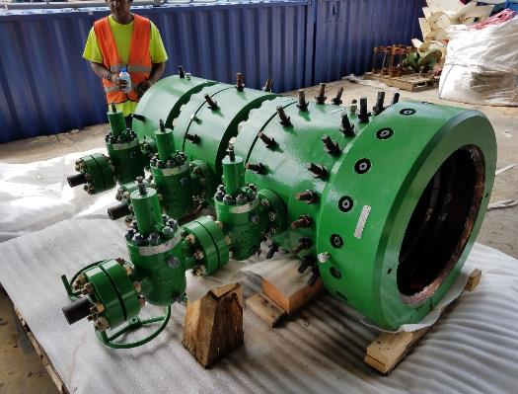
Client References…
EOG – Preservation of Wellhead Equipment
Before After

Slide 10
Client References…
ExxonMobil Malaysia – Preservation of Halliburton Screens
Before After

Slide 11
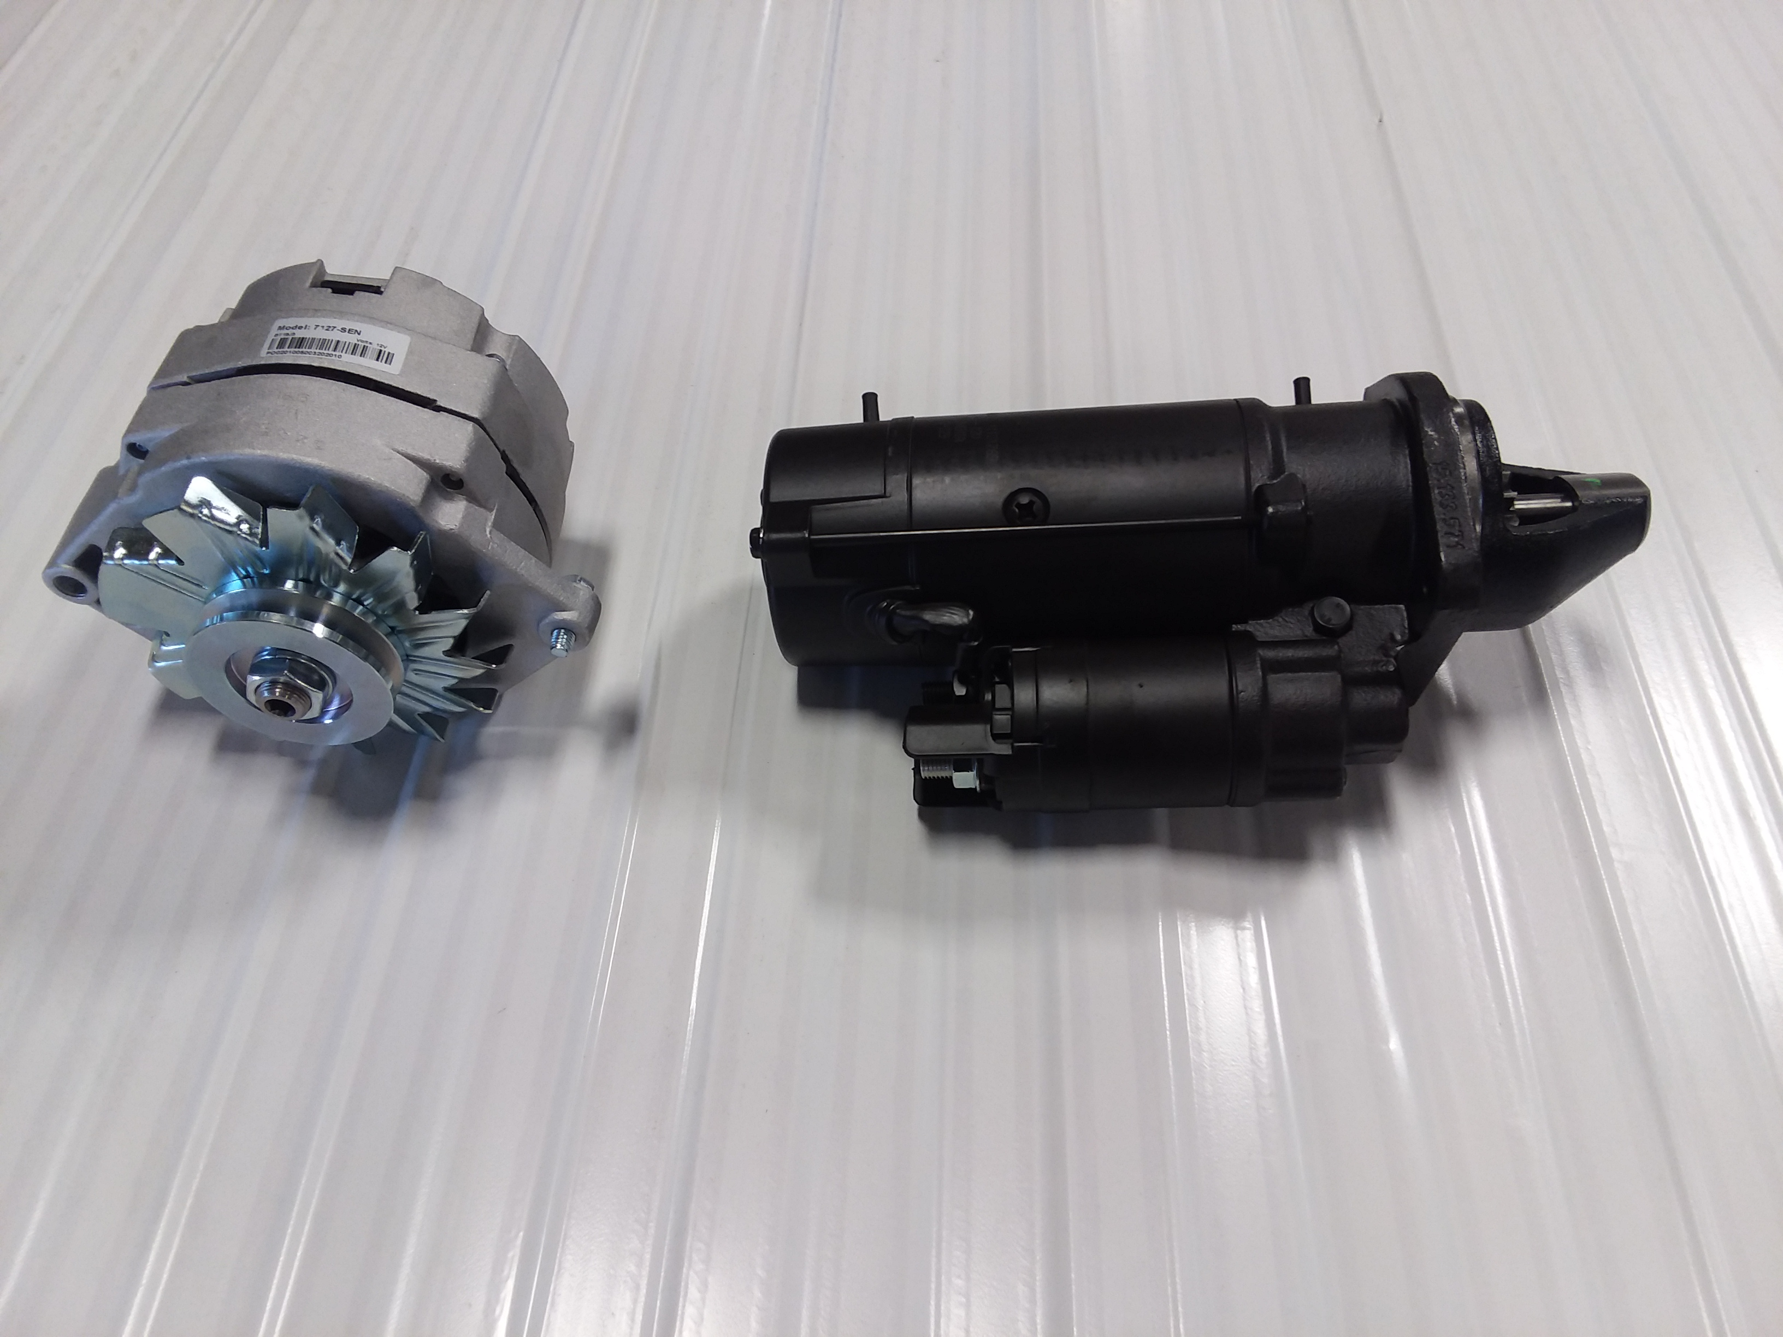
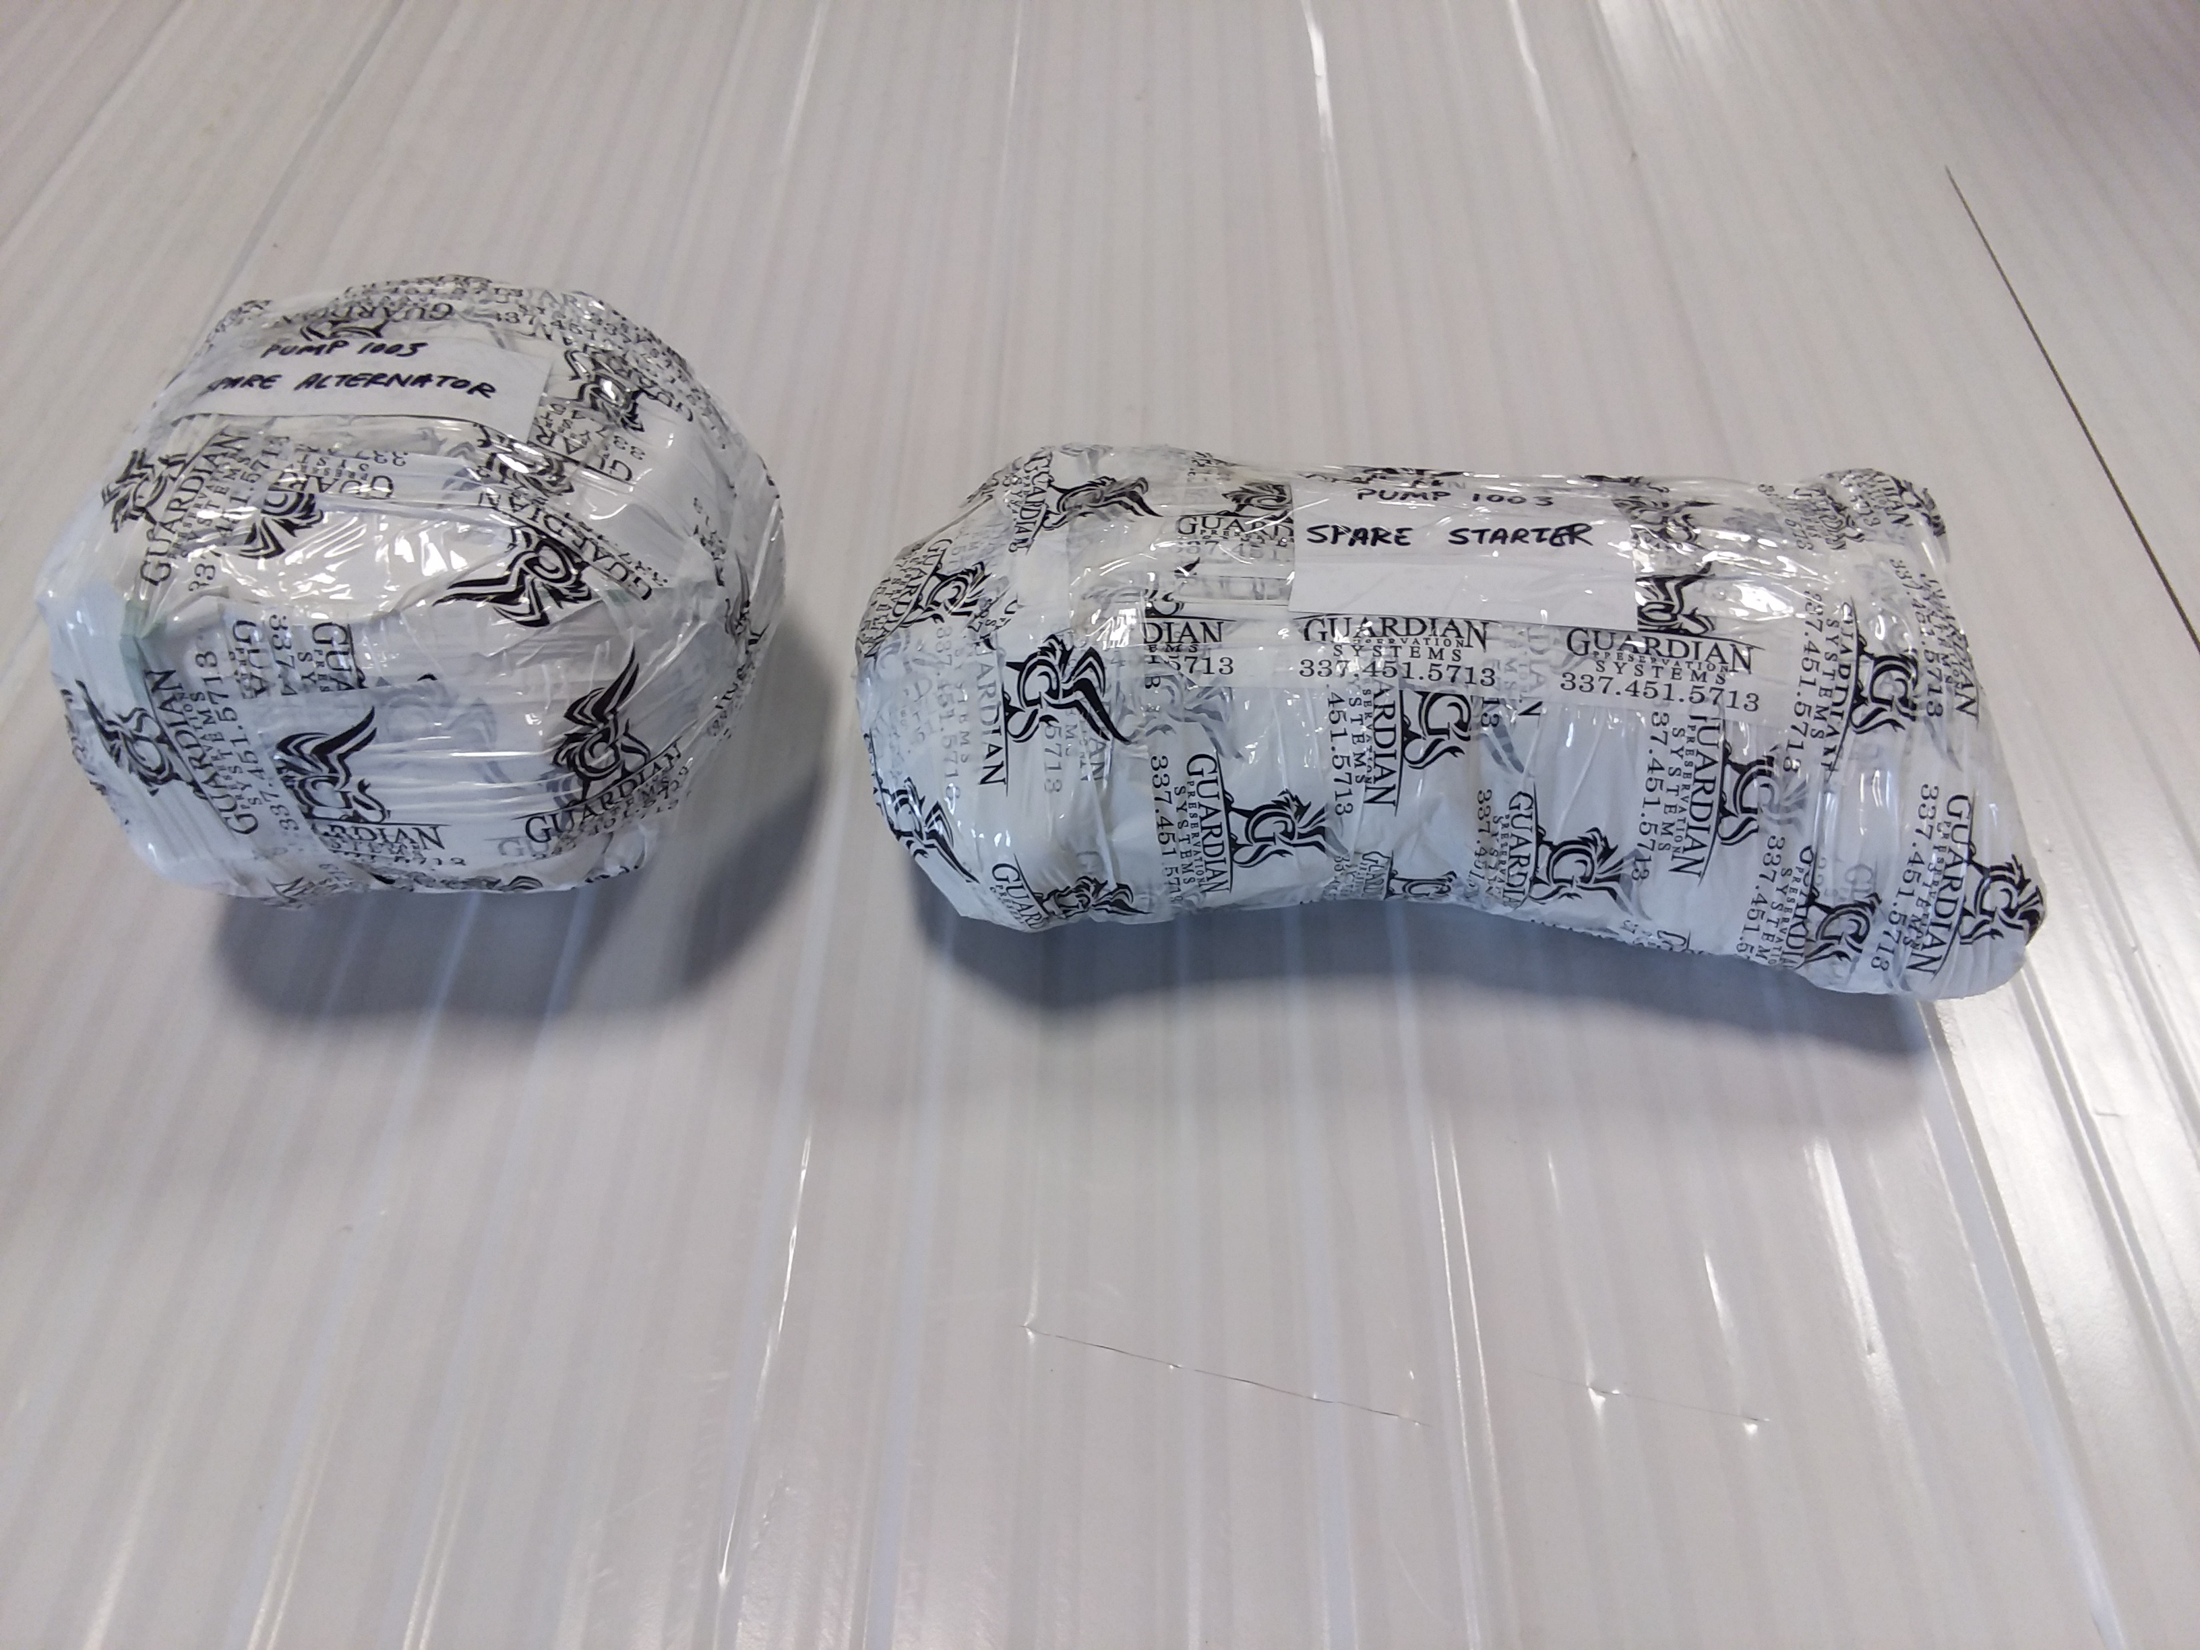
Client References…
Small Spare Parts Solutions
Before After

Slide 12
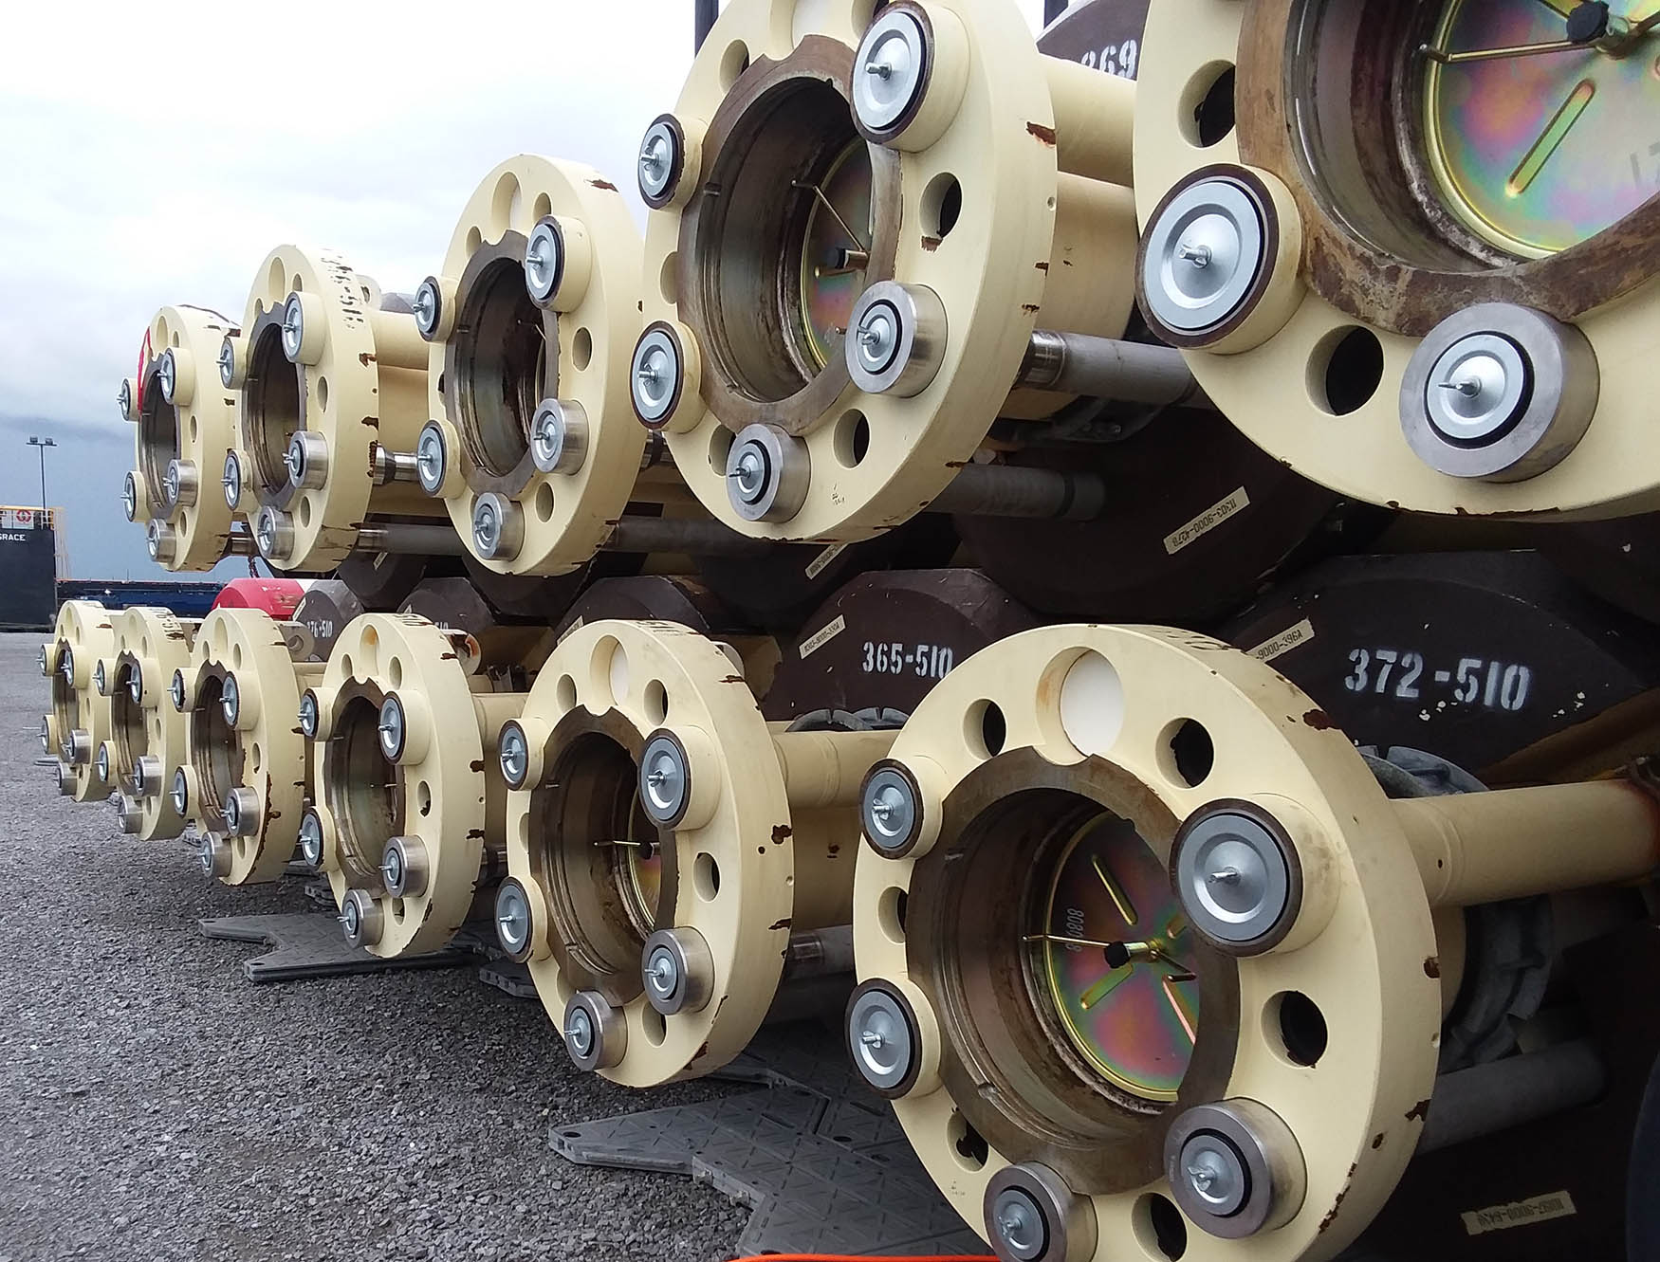
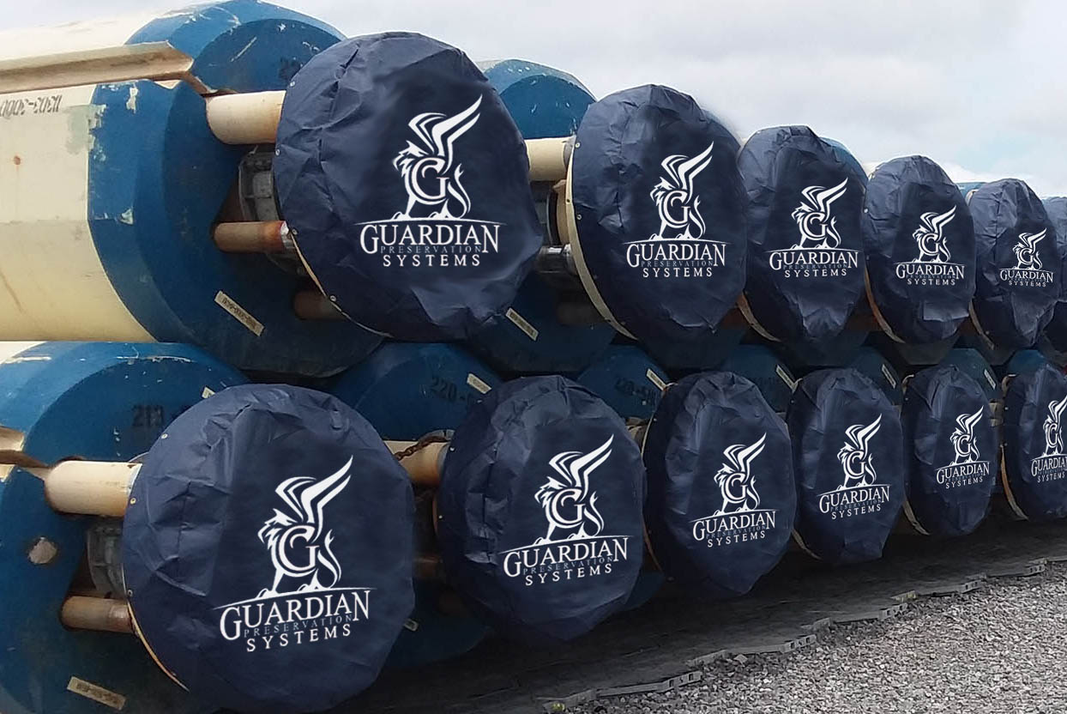
Client References…
Riser Solutions
Before After

Slide 13
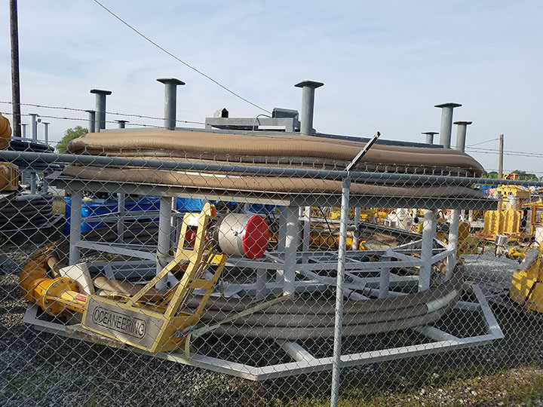
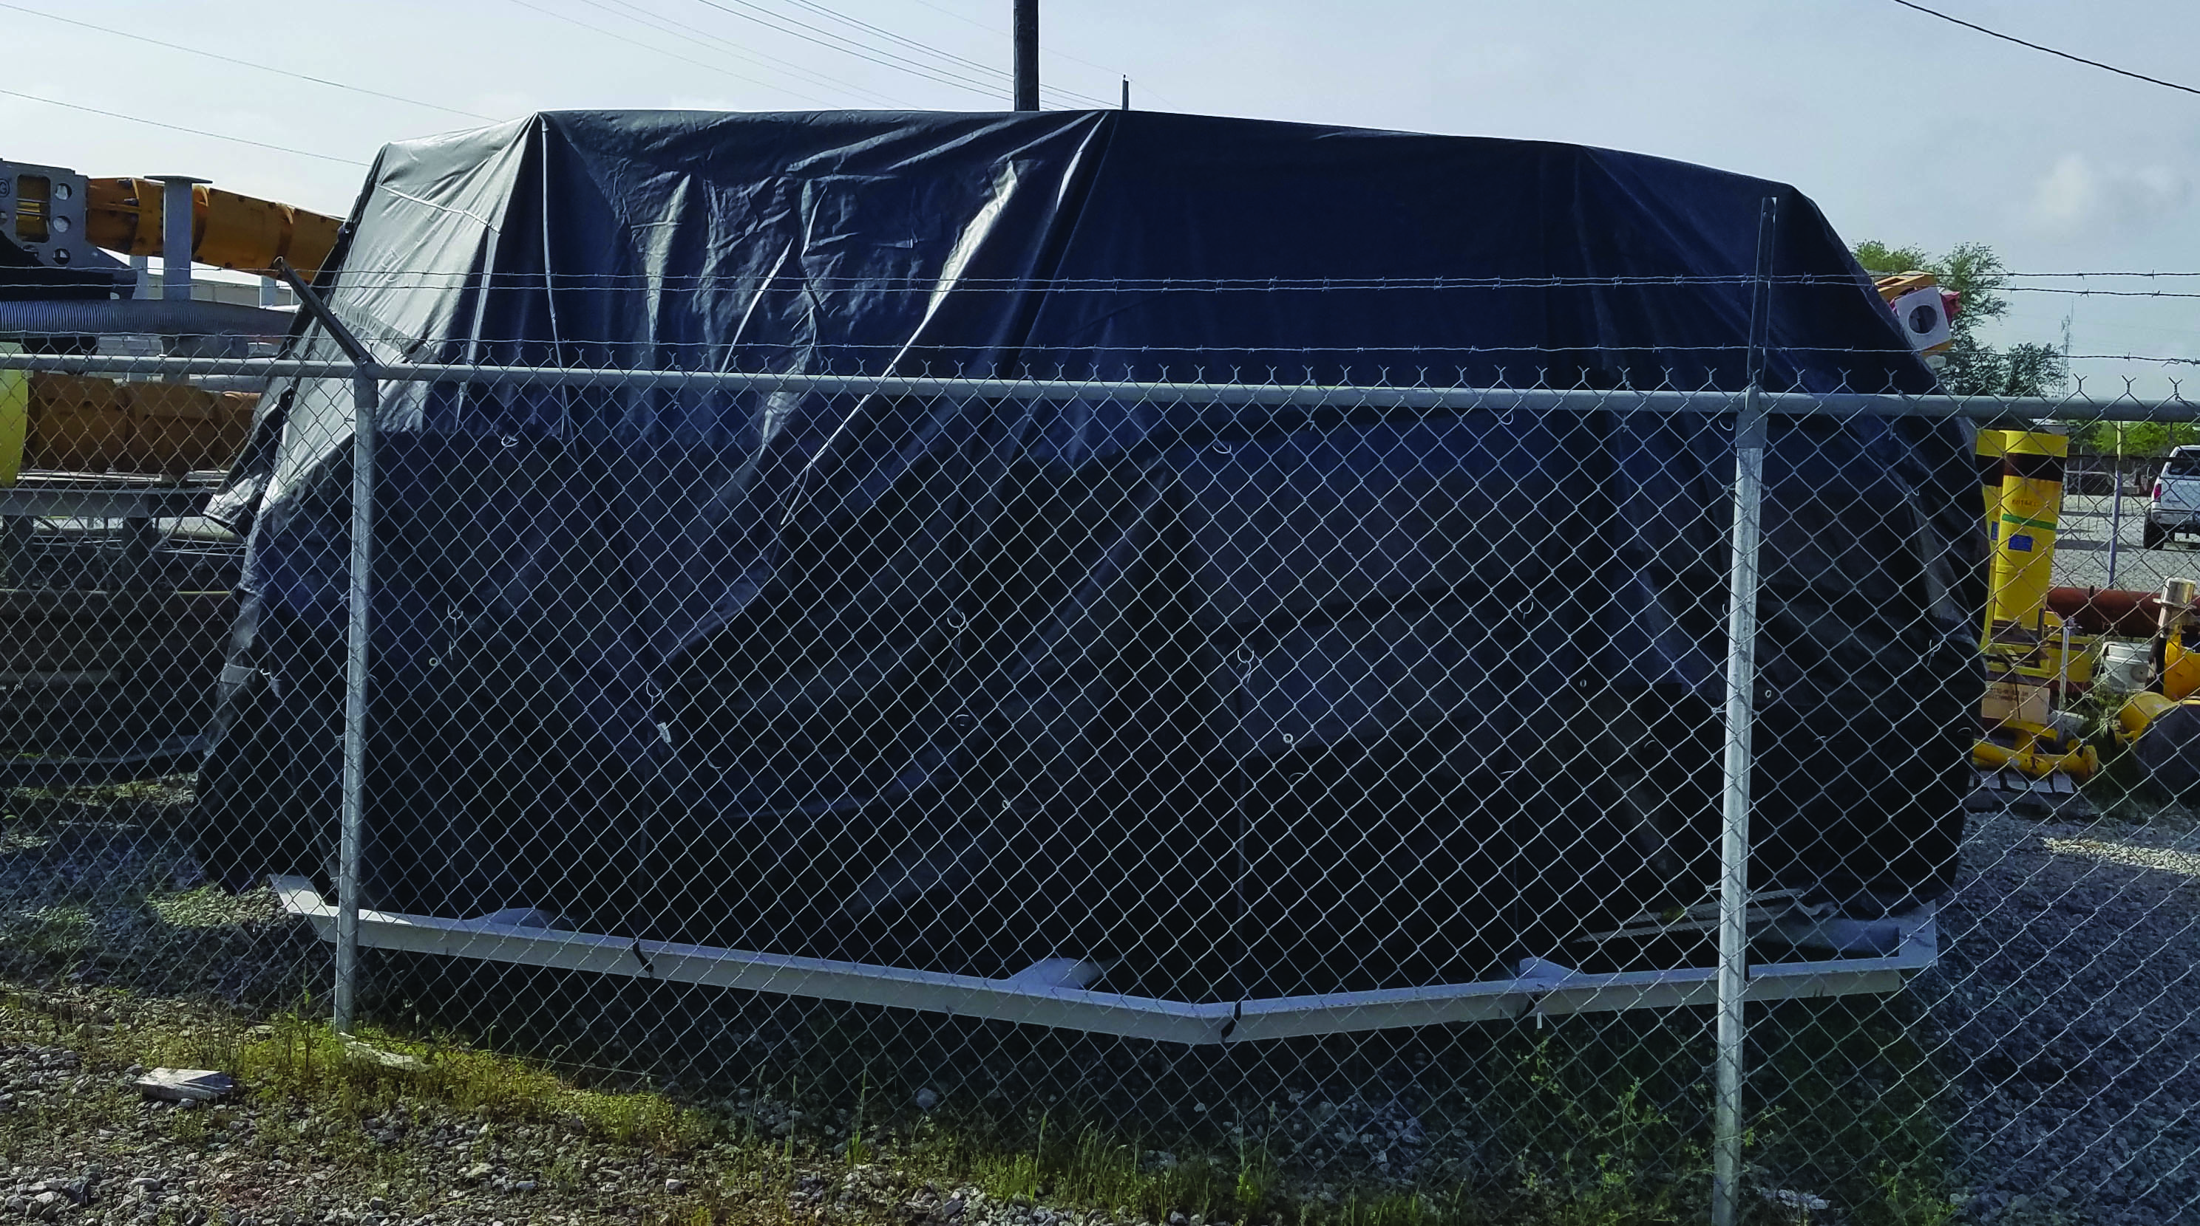
Client References…
Jacket Solutions
Heavy Duty 22oz vinyl
10 – year life
Custom built
Grommets, straps, buckles…
Before After

Slide 14
Key Benefits from Our Solution…
Suitable for preservation of a wide range of equipment & materials
Clean, safe & easy to use
Huge savings with reduced total equipment ownership cost
Addresses UV exposure challenges
Safe on other materials such as plastics, rubber and vinyl
Not permanent; allows for flexibility
No Chemicals; can be recycled
Alters the environment to remove moisture and humidity
No reapplication, purge is permanent until removed
Extended storage period (Over 10 year plus)
Is re-usable when applied
Waste reduction as material is built for individual item rather that large rolls
Available 24/7 local technical support
Successful track record with key customers such as ExxonMobil, EOG, etc

